Slide 1


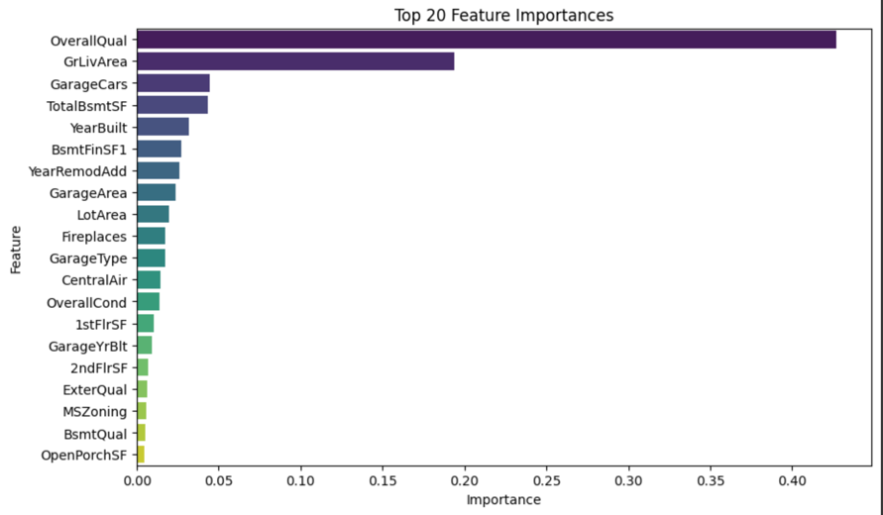
Predicting Housing Prices: Advanced Regression Techniques Using Machine Learning
[Sandeep Karumudi]
Abstract
Classification Of Tools and Models
Tool/ Model | Purpose | Advantages
Linear Regression | Establish baseline performance for model evaluation. | Simple and interpretable; it provides a benchmark for comparison.
Ridge/LASSO Regression | Address multicollinearity and perform feature selection. | It improves model generalization and reduces overfitting.
Random Forest Regression | Capture nonlinear relationships and interactions between features. | Handles large datasets and captures complex feature interactions effectively.
XGBoost | Handle complex data structures and deliver high accuracy predictions. | Delivers high accuracy and handles missing data robustly.
Label Encoder | Transform categorical variables into numeric format. | Facilitates the use of categorical data in machine learning models.
Grid Search | Optimize hyperparameters to improve model performance. | Enhances model performance by systematically searching for the best parameters.
Pricing real estate accurately is essential for a fair and efficient housing market, but traditional methods are often limited by subjectivity and manual effort. This project uses machine learning to predict housing prices based on data from Ames, Iowa. By exploring multiple models, XGBoost achieved the best performance with an RMSE of 0.14. Our findings highlight how data-driven techniques can streamline valuation processes, enhance pricing accuracy, and enable better decision-making.
Problem Statement
Accurate property valuation is vital in the real estate market, but traditional methods are often time-intensive and error-prone. Factors such as location, structural characteristics, and market conditions contribute to price volatility, posing challenges for buyers, sellers, and realtors. There is a clear need for automated, data-driven valuation techniques to enhance accuracy and efficiency while minimizing human error.
Methodology
Conclusion
Feature Engineering:
Created total square footage, interaction terms (e.g., mass × square footage), and time-based features (e.g., years since last remodel).
Models Explored:
Linear Regression (baseline)
Ridge/LASSO Regression (feature selection)
Random Forest Regression (nonlinear relationships)
XGBoost (final model for capturing complex patterns)
Evaluation Metric:
Root Mean Square Error (RMSE).
This project highlights how machine learning, particularly XGBoost, can revolutionize real estate pricing by enhancing accuracy and reducing human error. With an RMSE of 0.14, the model demonstrates robustness and scalability for broader applications. By leveraging data-driven insights and periodic updates, this approach ensures relevance, operational efficiency, and improved decision-making for the real estate market.
The XGBoost model demonstrates superior predictive power with low RMSE.
Machine learning reduces human error and automates property valuation, enhancing buyer and seller confidence.
Dataset and Preparation
Source: Kaggle competition on housing prices in Ames, Iowa.
Details: The dataset contains 79 features describing residential properties.
Preprocessing: Addressed missing values and encoded categorical features using label encoding.
Categorical Encoding: Transformed categorical variables into a numeric format using label encoding to ensure compatibility with machine learning algorithms.
Outlier Handling: Identified and mitigated extreme values in features to reduce their impact on model training.
Results and Insights
Performance:
Baseline Linear Regression RMSE: 0.35
Final XGBoost RMSE: 0.14 (Improvement in accuracy).
Insights: Feature engineering enhanced predictive accuracy, and XGBoost effectively captured complex relationships.
Contact
Sandeep Karumudi
Karumudi@wisc.edu +1 608 (707)-2216

